Slide 1
Predictive Modelling and Patient Segmentation of Cardiovascular Outcomes Using MEPS Data
Capstone Project Presentation for ALY 6140
Team Members: Isaac Nyinaku, Neeti Shah, Maria Menendez, Hongru Chen
Professor: Zhi He
Date: May 12, 2025
Notes:
Good afternoon everyone. Thank you for joining us today. We’re excited to present our project on Predictive Modelling and Patient Segmentation of Cardiovascular Outcomes Using MEPS Data. This work was done by our team — Isaac Nyinaku, Neeti Shah, Hongru Chen and myself Maria Menendez

Slide 2
Table of Contents
Introduction
Data Preparation
Exploratory Data Analysis (EDA)
Correlation Analysis
Predictive Modeling
ROC Curve
Model Performance
K-Means Clustering for Patient Segmentation
Clustering Interpretation
Conclusions
Notes:
Let's begin by outlining the structure of our presentation. First, I will walk you through the Introduction where we define our objectives. Following that, we will discuss the Data Preparation process. Then, we'll dive into the Exploratory Data Analysis (EDA) and Correlation Analysis to set the stage for our modeling techniques. The Predictive Modeling section will present the logistic regression used for stroke prediction. We will then evaluate the Model Performance and explore K-Means Clustering to segment patients based on cardiovascular conditions. Finally, we’ll discuss our Clustering Interpretation and conclude with key findings and future directions.

Slide 3
Introduction
Predicting stroke likelihood
Identifying patient subgroups using unsupervised learning
Implications for healthcare interventions
Notes:
Our project focuses on two main objectives. First, we aim to predict the likelihood of stroke using various demographic and clinical indicators. This can help in identifying high-risk individuals who may benefit from early interventions. Second, K-Means clustering, to identify distinct patient subgroups based on shared patterns in cardiovascular disease, such as heart disease, stroke, and heart attack. By leveraging these techniques, we hope to provide actionable insights for healthcare interventions and resource allocation.

Slide 4
Data Preparation
Dataset Overview: 22,431 records, 1,400 variables
Features: age, sex, race, region, insurance status, and four cardiovascular-related conditions—heart disease, angina, heart attack, and stroke
Data Cleaning: Handling missing values and variable renaming
Notes:
We began with a large dataset containing 22,431 records and 1,400 variables. For our analysis, we focused on a subset of key features: demographic information like age, sex, race, region, and insurance status, along with four cardiovascular-related conditions—heart disease, angina, heart attack, and stroke.
To prepare the data, we cleaned up missing values by assigning them the value of the median and standardized variable names, ensuring that the data was analysis-ready and easy to interpret.

Slide 5
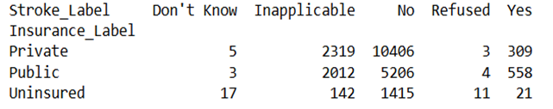
Exploratory Data Analysis (EDA)
Descriptive Statistics: Distribution of key variables (age, insurance status)
Insurance and Stroke: Cross-tabulation results
Figure 1: Stroke Diagnosis by Insurance Status
Notes:
We began our analysis with exploratory data analysis. This data included descriptive statistics, which revealed that the age distribution ranged from young children to older adults. The age variable, in particular, had a strong correlation with cardiovascular conditions. One of the first insights we gained was the relationship between stroke diagnosis and insurance status. We found that strokes were more common among individuals with public insurance compared to private insurance and the uninsured. This could indicate differences in healthcare access or care quality. We also visualized the age distribution, which showed peaks in three distinct age groups: children and adolescents, middle-aged adults, and older adults nearing retirement.

Slide 6
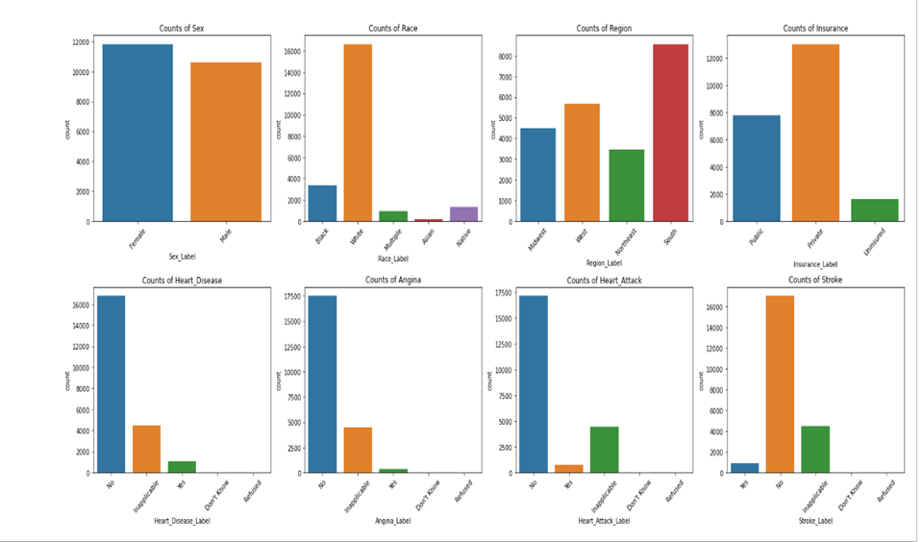
Demographic and Condition Distributions
Notes:
This slide provides a unified overview of both demographic and cardiovascular health distributions in our dataset.
Starting with the Sex variable, we observe a fairly balanced representation of males and females.
The Race distribution, however, is notably imbalanced. The White population forms a significant majority, with other racial groups like Black, Asian, Native, and Multiracial being underrepresented. This highlights a potential bias we need to be aware of when interpreting results and building models.
Looking at Region, the South is the most represented region, followed by the Midwest, West, and Northeast. This suggests that geographic location may influence the sample characteristics.
In terms of Insurance Status, most individuals are privately insured, followed by those with public insurance, and a smaller group that is uninsured. This could have meaningful implications for healthcare access and outcomes.
Moving into the health condition variables, we see that most individuals reported no diagnosis for heart disease, angina, heart attack, and stroke.
However, there are still substantial counts for those diagnosed with these conditions, particularly for angina and heart attack.

Slide 7
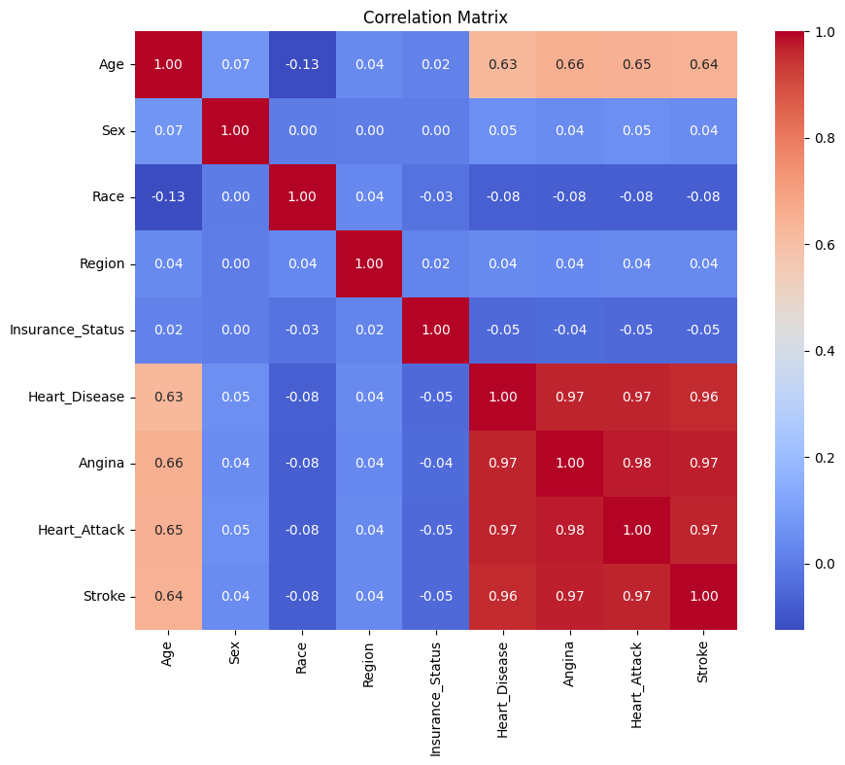
Correlation Analysis
Key Insight: Strong correlation between age and health conditions
Figure 3: Stroke Diagnosis by Insurance Status Correlation Matrix of Cardiovascular Condition
Notes:
This heatmap illustrates the correlation matrix among our numeric variables. The key takeaway here is the strong positive correlation between age and all cardiovascular conditions. For example, age has a correlation of 0.66 with angina and 0.65 with heart attack.

Slide 8
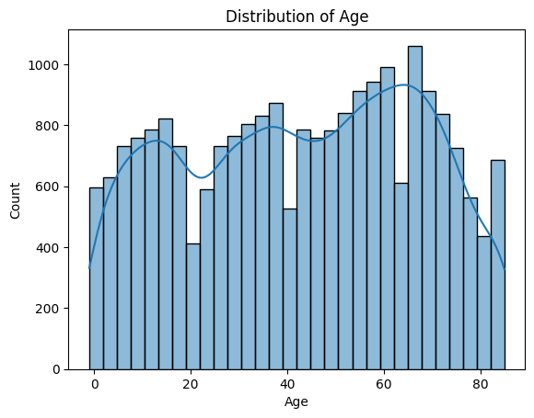
Distribution of Age
Figure 4: Distribution of Age in the MEPS Dataset Stroke Diagnosis by Insurance Status
Notes:
As shown in this chart, the age distribution skews older, which aligns with known risk factors for cardiovascular disease. This variable became a key input in our model due to its strong predictive value.

Slide 9
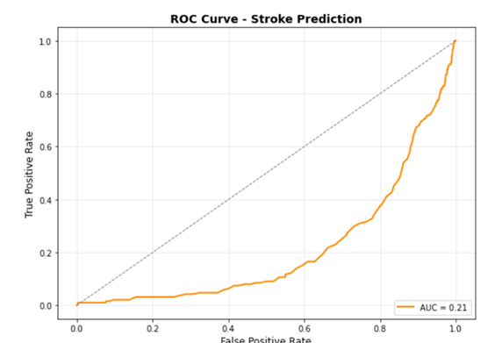
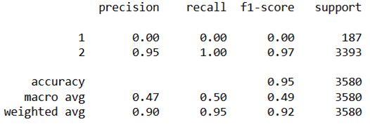
Predictive Modeling
Figure 5: Logistic Regression Classification Report
Figure 6: Stroke Prediction - ROC Curve
Notes:
We developed two logistic regression models—one to predict stroke diagnosis, and the other to predict insurance coverage. These outcomes were selected to explore both clinical risk and healthcare access patterns using the available survey data.Before modeling, we cleaned the data using a custom filtering function. This step removed non-informative responses like “Don’t Know,” “Refused,” and “Inapplicable” from all disease-related variables, retaining only records with clear “Yes” or “No” answers. This ensured consistency and allowed us to treat each outcome as a binary classification task.For both models, we used the same set of predictors: age, sex, race, region, and the presence or absence of chronic conditions—specifically heart disease, angina, heart attack, and stroke (used as a predictor in the insurance model). After filtering, we split the dataset into training and testing sets using an 80/20 ratio and trained the logistic regression models accordingly.
In the stroke prediction model, while the overall accuracy was 95%, the model failed to identify any stroke cases. The recall and precision for the positive class were both zero, and the AUC was only 0.20. This indicates that although the model predicted the majority class well, it was unable to distinguish stroke cases from non-cases. The root cause appears to be the extreme class imbalance—very few stroke cases existed in the data—and limited predictive power in the features available.

Slide 10
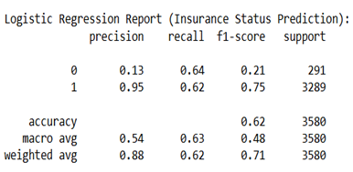
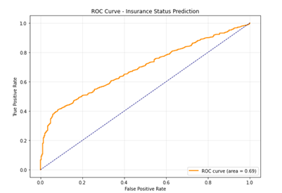
Logistic Regression Report
Figure 7: Logistic Regression Report - Insurance Status Prediction
Figure 8: Logistic Regression Report - Insurance Status Prediction
Notes:
In contrast, the insurance model performed better. We recoded the target into “insured” versus “uninsured” and used the same predictor set. The model achieved an AUC of 0.69 and performed well on the insured group. However, performance on the uninsured class was still weak, with low precision and recall. This is again due to imbalance—uninsured patients made up a small fraction of the data—and possibly due to missing socioeconomic predictors like income or employment.

Slide 11
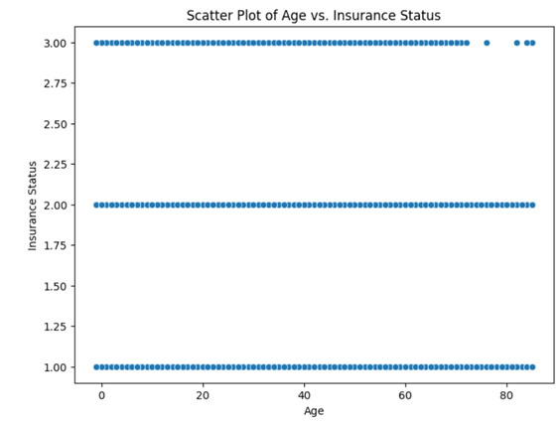
K-Means Clustering for Patient Segmentation
Age vs. Insurance: A clear separation of insurance categories by age.
Private vs. Public: More uniform distribution for public insurance.
Insights: Age plays a crucial role in insurance status and could inform targeted interventions.
Figure 9: Patient Segmentation Using K-Means Clustering
Notes:
Here, we present a scatter plot of Age vs. Insurance Status. This visualization shows the distribution of ages across three insurance categories: Private, Public, and Uninsured. The separation between these groups is clear, with Public insurance being more evenly distributed, while Private and Uninsured categories have more distinct age ranges. This information can help us understand how age influences insurance coverage and guide healthcare policy decisions.

Slide 12
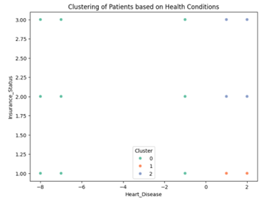
Clustering of Patients based on Health Conditions
Patient Segmentation: Clustering based on heart disease severity and insurance.
Clusters 1 and 2: High-risk patients with greater cardiovascular health issues.
Healthcare Targeting: Identifying patients who require more tailored interventions.
Figure 10: Patient Segmentation Using K-Means Clustering
Notes:
This scatter plot visualizes the clustering of patients based on heart disease severity and their insurance status. The K-Means clustering algorithm has segmented the patients into three distinct clusters. Cluster 0 represents individuals with minimal health issues, while Cluster 1 and Cluster 2 represent patients with varying severity of heart disease and insurance status. This segmentation helps in identifying high-risk patients who may require more focused care.

Slide 13
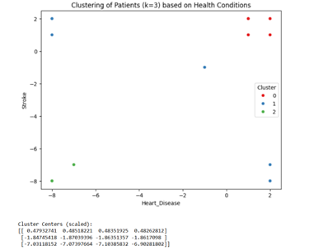
Clustering of Patients (k=3) Based on Health Conditions
k=3 Clusters: Dividing patients into three severity groups.
Cluster 2: High-risk group with severe cardiovascular conditions.
Actionable Insights: Targeting high-risk patients for early interventions.
Figure 11: Clustering of Patients (k=3) Based on Health Conditions
Notes:
This scatter plot represents the patient clustering with k=3 clusters. Each patient is grouped based on heart disease and stroke severity. The clusters show distinct health profiles. Cluster 0 has the lowest severity, while Cluster 2 has the highest, indicating severe cardiovascular conditions. By understanding these clusters, we can better allocate healthcare resources and identify which groups need urgent intervention.

Slide 14
Clustering Interpretation
Cluster 1: Healthy patients with low scores across conditions
Cluster 2: High-risk patients with multiple comorbidities
Cluster 3: Moderate risk, early-stage cardiovascular issues
Notes:
We interpreted the clustering results by examining the characteristics of each group. The first cluster, representing healthy individuals, showed low scores across all cardiovascular conditions. The second cluster included high-risk patients with multiple comorbidities, including high prevalence of heart disease and stroke. The third cluster contained patients with moderate scores, potentially representing those in the early stages of cardiovascular issues or individuals with selective diagnoses. These segments provide valuable insights for targeting healthcare resources, such as prioritizing high-risk patients for early intervention.

Slide 15
Conclusions
Predictive models for stroke can inform healthcare decisions but need to address class imbalance
Patient segmentation offers insights for targeted healthcare interventions
Future Directions: Improving predictive models and incorporating behavioral features
Notes:
In conclusion, our project demonstrated that predictive models for stroke, while informative, must address challenges like class imbalance to improve performance in identifying high-risk individuals. Additionally, patient segmentation via K-Means clustering offers a deeper understanding of disease burden and can aid in designing personalized healthcare interventions. Moving forward, we plan to refine our models by incorporating more granular features, such as behavioral data, and explore more sophisticated techniques like oversampling or ensemble models to improve predictive accuracy.

Slide 16
References
Agency for Healthcare Research and Quality. (2024). Medical Expenditure Panel Survey (MEPS) datasets.
Notes:
These are the references we used for our project. This includes the MEPS website we used for data extraction.
Thank You.

